Slide 1
Chapter 3
Poverty

Slide 2
Measuring Poverty: The Headcount Index
q = Number of people with income below the poverty line (which we’ll call z)
N = Total population

Slide 3
Advantages/Disadvantages
Easy to calculate
Just need z, q (add up how many people are in households below the poverty line), and N
Insensitive to how far below the poverty line the poor people are

Slide 4
The Poverty Gap (Depth) and Gap-squared (Severity)
For person i:
Total Poverty Gap:
Poverty Gap-Squared

Slide 5
Measuring Poverty: FGT
Headcount
Poverty Gap (Depth)
Severity of Poverty
3 in One: The Foster-Greer-Thorbecke measure (ranges from 0 (no poor) to 1 (everyone’s poor with zero income))

Slide 6
The Three FGT Measures
Derived from:
Headcount (α=0):
Poverty Gap (α=1)
Poverty Severity (α=2)

Slide 7
Recipe for Calculating the FGT
1. For each POOR household (y_{i}<z), calculate the poverty gap:
2. Raise it to the α power:
3. Take the sum (Σ) of gaps across all q poor households (add ‘em up):
4. Divide by (multiply by 1 over) Nz^{α}:

Slide 8
FGT: An Example

Slide 9
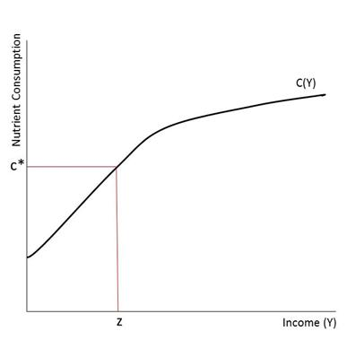
Where’s the Poverty Line?

Slide 10
Good News about Poverty in Rural Mexico

Slide 11
Bad News: Vulnerable to the Crisis:
Contributions of Income Sources to Poverty Reduction, 2002-2007

Slide 12
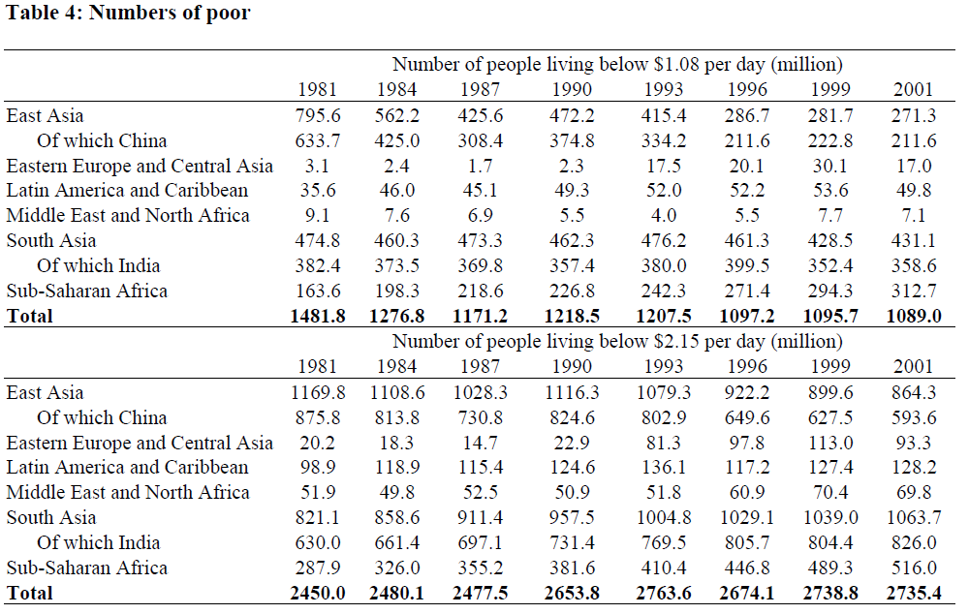
Table 6.3
Source: S. Chen and M. Ravallion, “How Have the World’s Poorest Fared Since the Early 1980s?” World Bank Policy Research Working Paper 3341, June 2004.

Slide 13
Mexico: Do Migrant Remittances Reach the Poorest Households?

Slide 14
Poverty Dynamics: It’s Harder than You Think

Slide 15
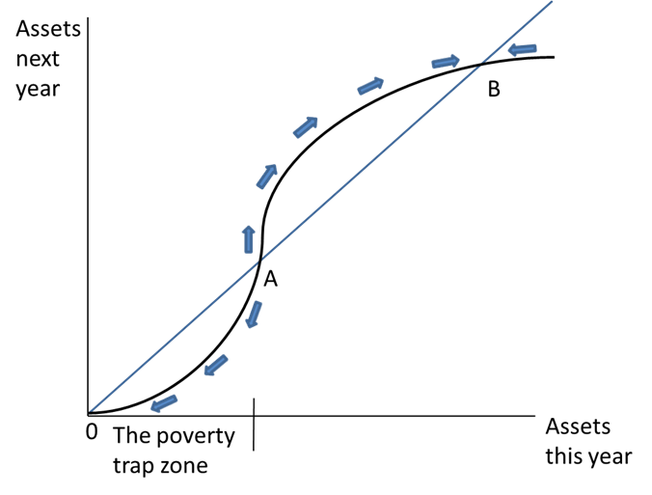
The Poverty Trap

Slide 16
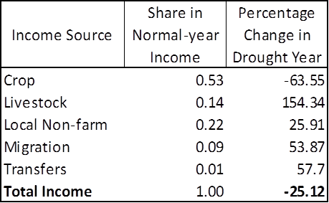
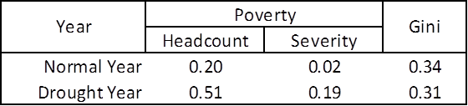
Inequality and Poverty: Agro-climatic Shock in the Sahel
Source: J. Edward Taylor and Thomas Reardon, "Agroclimatic Shock, Income Inequality, and Poverty: Evidence from Burkina Faso.” World Development 24(5):901-914, 1996.

